Slide 1
Will gun control curb violence?
Jonah Shi Stat4893W

Slide 2

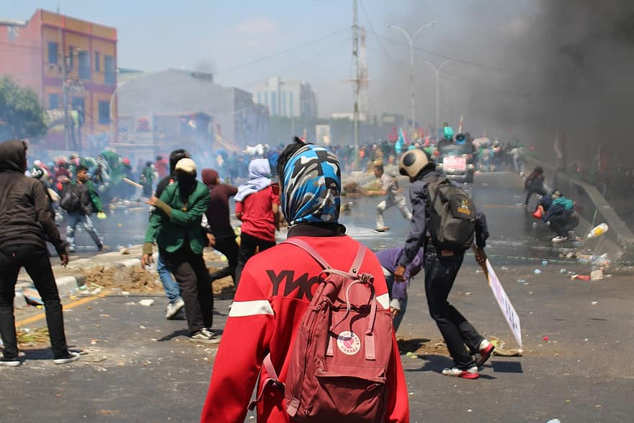
Introduction for research
Research Question：
How will the gun prohibition law influence violence.
If there are other aspects that will influence the violent situation.
The statistical method(s):
Random forest
Linear regression
Dataset: More Guns, Less Crime?
https://vincentarelbundock.github.io/Rdatasets/datasets.html
Notes:
1173 14

Slide 3
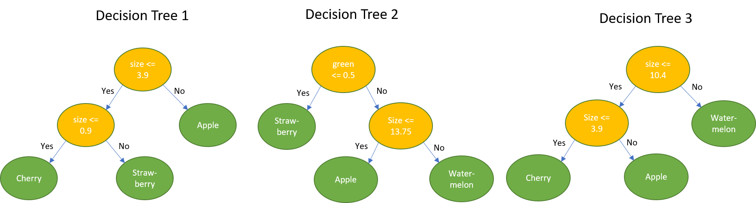
Advance method: Random Forest
Concepts: N(training sample), M(sample character number) , m(sample character number)
N
m

Slide 4
Advance method: Random Forest
Pros:
Good for testing outlier
For unbalanced data, it can balance the sample error
Cons:
Sacrifice the intrinsic interpretability present in decision trees.(reference 1)
（violent can be explained by years and income)
May not enhance the accuracy of the base learner.
(Linear regression can also do that)

Slide 5
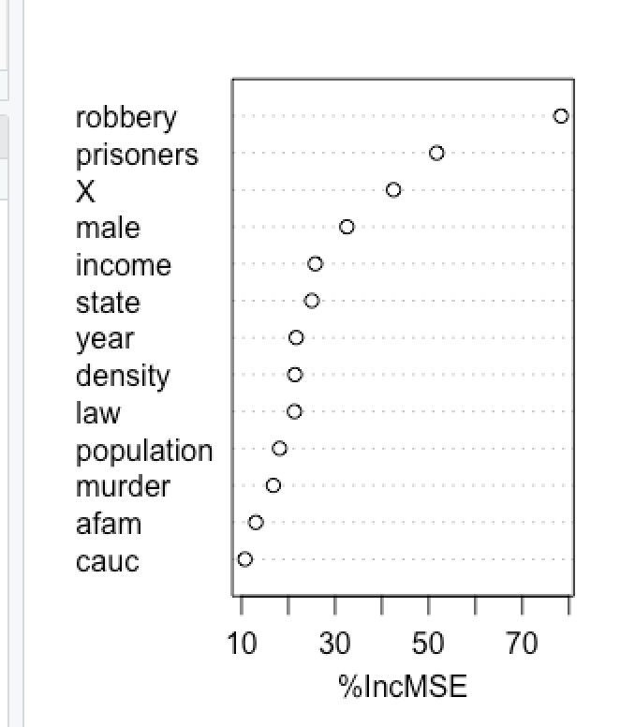
Results
Male and income is the most important variables among all the variables.
Law is also related to the violence, but it is the sixth important variables.

Slide 6
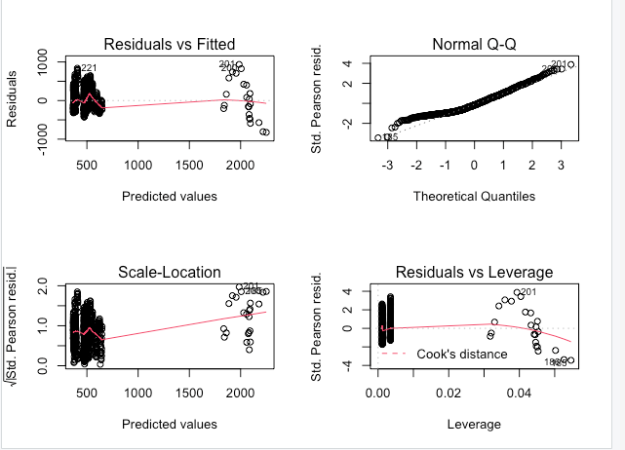
Linear regression model result
In my linear regression model, I have the final model be selecting the smallest AIC (Akaike information criterion) is
Violent is related to law, density, income and male.

Slide 7

Trouble for now
Limitation:
Independence assumption cannot be fulfilled
Data is from 1977 to 1999. It is outdated.

Slide 8
Reference
1.Santur, Y., Karaköse, M., & Akin, E. (2016, December). Random forest based diagnosis approach for rail fault inspection in railways. In 2016 National Conference on Electrical, Electronics and Biomedical Engineering (ELECO) (pp. 745-750). IEEE.

